Slide 1
Malicious & Malign Website Detection with Ensemble Model
By Dwiki Witman

Slide 2
Introduction
An ensemble model combines the predictions of multiple individual models to make a final prediction. In this case, the ensemble model utilizes both CatBoost and XGBoost, which are popular gradient boosting frameworks. By leveraging the strengths of both algorithms, the ensemble model aims to improve the overall predictive performance.
CatBoost specializes in handling categorical features efficiently, while XGBoost provides flexibility and various customization options. The ensemble model leverages the unique features of each framework to enhance its predictive capabilities, resulting in potentially improved accuracy and robustness.

Slide 3
Objectives
The objective is to classify Malicious (Type=1) websites from Benign (Type=0) ones on the basis of various features given in the dataset with Ensemble Model.
Target variable: "TYPE"

Slide 4
Approach
1) Explore the data
2) Clean the relevant data
3) Check imbalances (if any)
4) Use SMOTE to resolve imbalances
5) Feature Engineering and Feature Selection
6) Try and finalize a Machine Learning Model (XBoost and CatBoost)
7) Conclusion

Slide 5
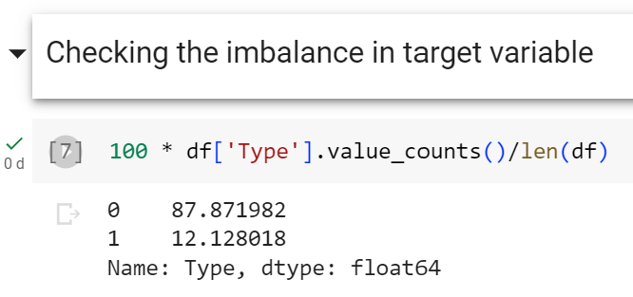
EDA: Imbalance Data
There is a significant class imbalance with a ratio of approximately 88% for Type=0 and 12% for the other class. We will address this issue later using SMOTE.

Slide 6
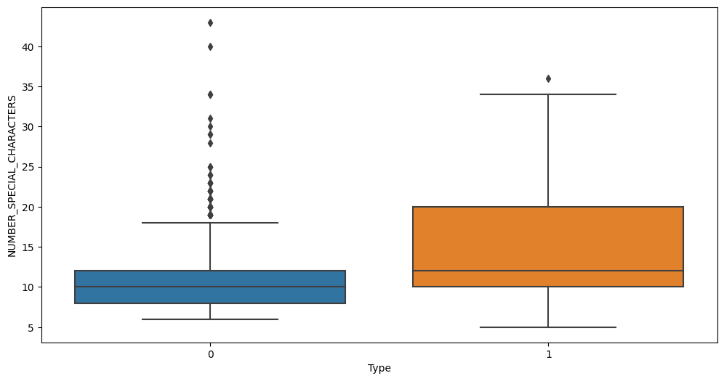
EDA: Type vs Number of special characters
The number of special characters for Malicious website is higher than benign ones.

Slide 7
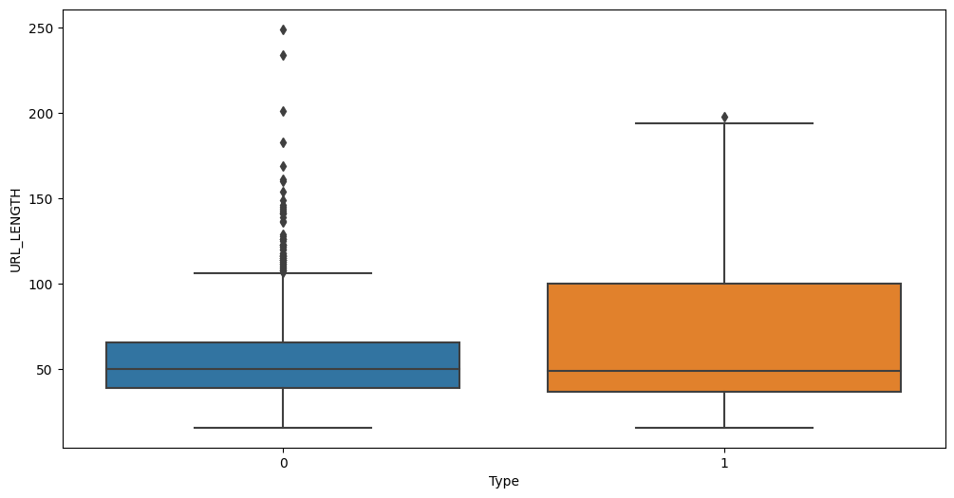
EDA: Type vs URL length
The mean length of URL is higher for Malicious website as compared to benign ones.

Slide 8
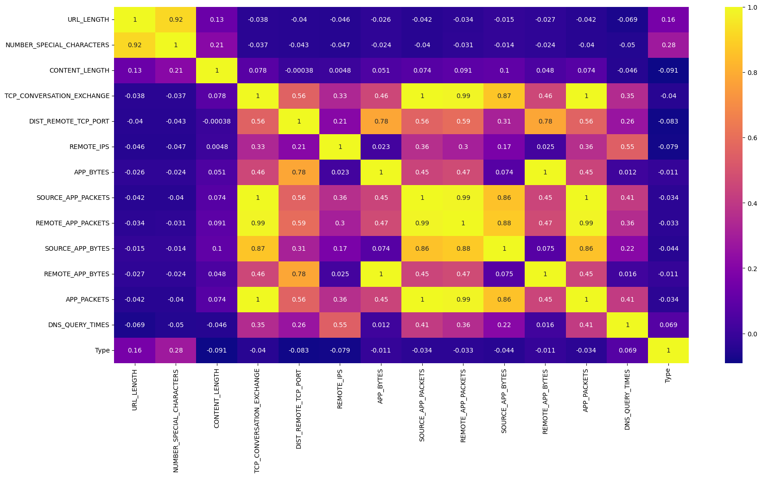
EDA: Heatmap Analysis
We should avoid removing all highly correlated features to retain meaningful insights. Instead, we should only drop columns with minimal impact on analysis and modeling. As "Content Length" has little correlation and many missing values, it is recommended to remove it.

Slide 9
Preprocessing Data
Preprocess Categorical Data
Transform
keep top 5 category in each categorical column
Changing categorical column into dummies
Resampling Data
Drop Column
Using SMOTE
Drop Content Length

Slide 10
Machine Learning Model
XGBoost
CatBoost
XGBoost combines the power of gradient boosting algorithms with a range of advanced features, including regularization techniques, parallel processing, and tree pruning.
CatBoost is an open-source gradient boosting framework that is specifically designed to handle categorical variables.
We're interested in a model which has high recall as we want to minimize Error at the same time keeping R2 high as well. Hence, we need to find a sweet spot while evaluating our model.

Slide 11
Tuning Final Model
eta = 0.1, max_depth = 3, n_estimators = 100, subsample = 0.8, reg_lambda = 0.5 I choose the parameter based on which has low point on tuning graph, which means minimum error
XGBoost w/ Tuning | r2 score | MAE | MSE | RMSE
train | 0.8475498517761535 | 0.060625739917280076 | 0.015535393765867447 | 0.12464105971094536
test | 0.7111521502716216 | 0.09665790719050113 | 0.0360284907879861 | 0.1898117245798744

Slide 12
Tuning Final Model
eta = 0.1, max_depth = 6, n_estimators = 200, subsample = 0.8
I choose the parameter based on which has low point on tuning graph, which means minimum error
CatBoost w/ Tuning | r2 score | MAE | MSE | RMSE
train | 0.9793263646922183 | 0.002106741573033708 | 0.002106741573033708 | 0.045899254602157845
test | 0.6171558704453443 | 0.047752808988764044 | 0.047752808988764044 | 0.21852416110985085

Slide 13
Conclusion
XGBoost Classifier is the best optimal model for our data as it is quite robust, immune to multicollinearity and has high R2 score and with minimum error on train and test.
Catboost tends to overfitting because it has good score in train but low score in test, example on R2 score.

Slide 14
THANKS!
Do you have any questions?
https://www.linkedin.com/in/dwiki-witman-308424118/
https://medium.com/@yohanesdwikiwitman

